Slide 1
Introduction to Chemistry: Atoms and Ions
Jason R. Mayberry, PhD

Slide 2
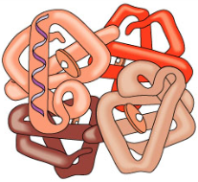
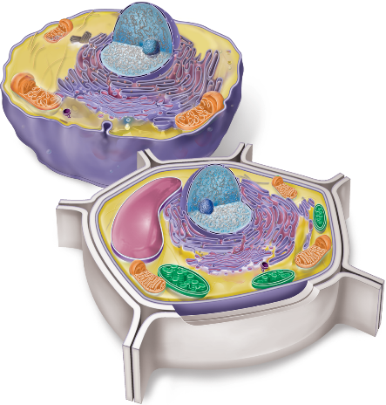
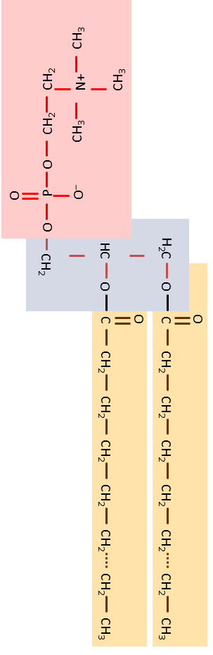
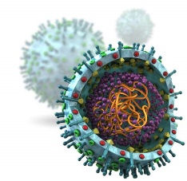
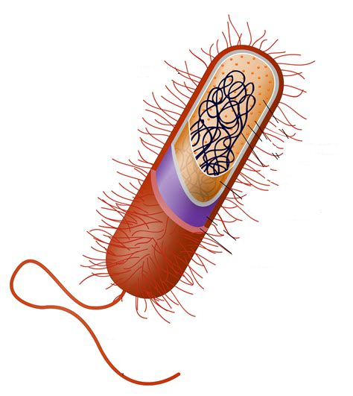
Levels of Organization
δ–
O
O
1
H
O
δ+
δ+
6
H
O
C
O
NH₂
+1
O
N
C
C
N
HC
A
H⁺
P
O
N
C
C
O
CH₂
–
O
N
H
11
H⁺
O–
OH
OH
Atoms and Ions
Simple Molecules
Macromolecules
Cells
Smallest part of an element that maintains the properties of that element.
Basic Building block of all ordinary matter.
Formed when a small number of atoms join together
Formed when a large number of atoms join together, often by linking simple molecules together in repetitive patterns.
Smallest living thing.
Formed when chemistry of a self-contained system becomes self sustaining.
How would you define life?

Slide 3
Chemistry Basics for Budding Biologists
Dr. Jason Mayberry
Castle View High School

Slide 4
Atoms
Atoms: the basic building blocks of all ordinary matter
Protons (p+)
Found in center region called nucleus
Charge: +1
Atomic Number: Number of protons which determines the properties and identity of the atom
Atoms represented by 1 or 2 letter symbols (as seen in the periodic table)
Atom with 6 p+ = Carbon (C)
Neutrons
Found in the nucleus
No charge
Some variation in number
Mostly unimportant for us except that too many can make an atom radioactive
Electrons (e-)
Found in regions surrounding the nucleus (the electron cloud)
Charge: -1
Generally the same number of e- as p+
Store electromagnetic energy (seen in chemical reactions.)
Determine the behavior of an atom

Slide 5
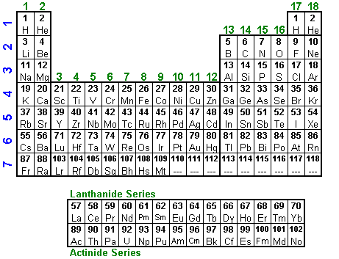
Atomic Number and the Periodic Table
Atoms are arranged on the periodic table according to their Atomic Number
Atomic Number = Number of Protons
Atomic Symbol for an atom/element

Slide 6
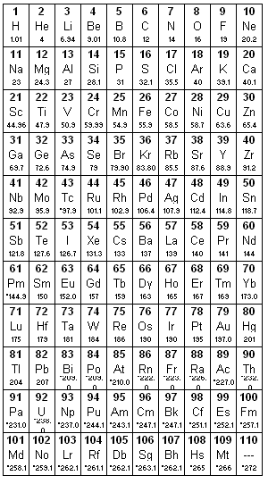
So Why is the Periodic Table Shaped…
Like This…
Instead of like This?
The Periodic Table was made by making placing atoms with similar properties (behavior) in columns
Electrons are responsible for the behavior of an atom.
The Shape of the Periodic Table is indicative of the arrangement of the electrons around the atom.

Slide 7
Energy Shells
The Electron Cloud is divided into 7 Energy Shells according to
  The distance of the electron from the nucleus
  The distinct energy of the electrons in the electron cloud
The 7 Energy Shells of an atom correspond to the 7 rows on the periodic Table.
Note: Each energy shell is also divided into “sub-shells” with more specific energy.
Energy shells closer to the nucleus are smaller and hold fewer electrons
Electrons want to have the lowest energy possible so will generally be in the lowest energy shell possible (lazy electrons!)
Greater Distance
1
2
3
4
5
6
7
Higher Energy

Slide 8
Electron Configuration
Electron Configuration: the location and arrangement of electrons around an atom.
Valence Electrons: electrons in the outer-most energy shell.
The atoms behavior (which atoms it will form molecules with and in what way) is a result of the Electron Configuration within the electron cloud, and almost exclusively the number of valence electrons.
1
2
3
4
1
2
1
2
3
Calcium
Argon
Carbon

Slide 9
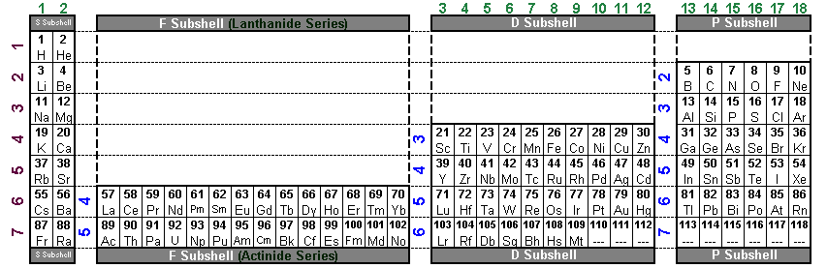
How to Determine the Number of Valence Electrons of an atom
Find the row that the atom is on
Count from the left end of the row to the atom
Your answer is the number of valence electrons
Note: Ignore the two middle blocks!
11
12
13
14
15
21
22
23
24
25
31
32
33
34
35
41
42
43
44
45
51
52
53
54
55
16
17
18
19
20
26
27
28
29
30
36
37
38
39
40
46
47
48
49
50
56
57
58
59
60
10
1
2
3
4
5
6
7
8
9
61
62
63
64
65
71
72
73
74
75
81
82
83
84
85
91
92
93
94
95
101
102
103
104
105
111
112
113
114
115
66
67
68
69
70
76
77
78
79
80
86
87
88
89
90
96
97
98
99
100
106
107
108
109
110
116
117
Always go in the valence shell.
118
Always go in the valence shell.
1
2
3
4
5
6
7
Electrons always go on the inside of the atom
Atoms in the same group always have the same number of valence electrons ∴ similar properties

Slide 10
Periodic Table of the Elements
How to Determine the Number of Valence Electrons of an atom:
Find the row that the atom is on.
Starting at the left end of the row, count the number of spaces up to the atom in question.
Your answer is the number of valence electrons.
Note: Don’t count spaces in the two middle blocks!
Always go in the valence shell.
Always go in the valence shell.
Electrons always go on the inside of the atom
Atoms in the same group always have the same number of valence electrons ∴ similar properties

Slide 11
Lewis Dot Structure (for atoms)
Lewis Dot Structure: Diagram of an atom with the following features
Uses the Chemical Symbol to represent the atom
Places “dots” around the symbol to represent ONLY the valence electrons
General Guidelines
  Draw electrons one at a time in the following pattern, stopping when you get to the number needed.
  Draw the first four in order: left side, top, right side, bottom
  Draw the last four in the same pattern to make pairs of electrons
Hydrogen
Carbon
Oxygen
Neon
H
C
O
Ne

Slide 12
Atoms Can Gain/Lose Electrons
Foundation:
Each Proton has a +1 charge
Each Electron has a -1 charge
When an atom has the same number of electrons as its protons, they + and – charges cancel out, leaving it neutral (charge of 0).
Neutral Atom
Negative ion
Neutral Atom
Positive Ion
+1
–1
Cl
Cl
Na
Na
Gain an electron
Lose an electron
+17
-17
+17
-18
+11
-11
+11
-10
0
-1
0
+1
∴ gaining electrons results in a negative charge
∴ losing electrons results in a positive charge

Slide 13
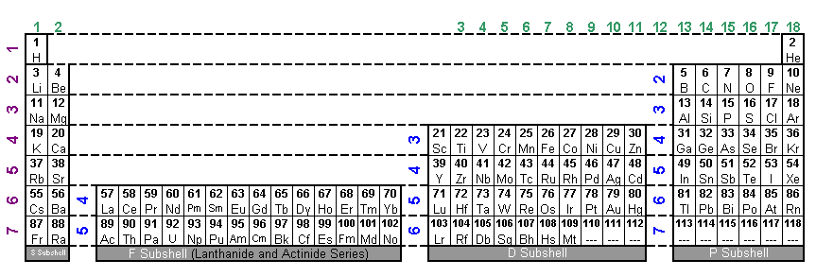
Why Form Ions?
Atom’s Requirements to be Stable:
  Be Neutral: Have the same number of Electrons as it does Protons.
  (As we’ve presented them….all start out with this desire met.)
  Octet Rule: Once a row on the Periodic table is started, finish the row or empty it.
  ∴ Atoms will seek to have 8 or 0 valence electrons (2 or 0 for H and He)
Only group 18 (Noble Gasses) satisfies both; the rules conflict for all other atoms.
When alone atoms must “choose” which to satisfy.
Satisfy Octet Rule If…
Only need to gain or lose 1 or 2 electrons to get there
Remain Neutral If…
Need to gain or lose more than 2 electrons to satisfy the octet rule.
11
12
13
14
15
21
22
23
24
25
31
32
33
34
35
41
42
43
44
45
51
52
53
54
55
16
17
18
19
20
26
27
28
29
30
36
37
38
39
40
46
47
48
49
50
56
57
58
59
60
10
1
2
3
4
5
6
7
8
9
61
62
63
64
65
71
72
73
74
75
81
82
83
84
85
91
92
93
94
95
101
102
103
104
105
111
112
113
114
115
66
67
68
69
70
76
77
78
79
80
86
87
88
89
90
96
97
98
99
100
106
107
108
109
110
116
117
118
2
3
4
5
7
1
6

Slide 14
Group 18
Noble Gasses have both requirements met independently
He
Ne

Slide 15
Groups 6 and 7
Group 16 and 17 atoms can gain electrons to satisfy the octet rule
When they gain electrons they then have more electrons than protons and ∴ have a negative charge.
Anion: atom with a – charge.
Note: the name of the ion is changed to end with –ide (e.g. Chloride, Oxide, Fluoride)
Neutral but no Octet
Octet but charged
–1
Cl
Cl
–2
O
O

Slide 16
Groups 1 and 2
Group 1 and 2 atoms can lose electrons to satisfy the octet rule…
…The now empty valence shell reveals the 8 in the previous shell.
When they lose electrons they then have more protons than electrons and ∴ have a positive charge.
Cation: atom with a + charge.
Neutral but no Octet
Octet but charged
+1
Na
Na
Na

Slide 17
Groups 1 and 2
Group 1 and 2 atoms can lose electrons to satisfy the octet rule…
…The now empty valence shell reveals the 8 in the previous shell).
When they lose electrons they then have more protons than electrons and ∴ have a positive charge.
Cation: atom with a + charge.
Neutral but no Octet
Octet but charged
+1
Na
Na
+2
Ca
Ca

Slide 18
Ions
Ion: Any atom with a charge
Cation:
an ion with a positive charge
Note the “t” looks like a + sign.
Anion:
an ion with a negative charge
Think of the “n” as standing for “negative”
+1
–1
Na
Cl
+2
–2
Ca
O
Atoms typically only form ions if the charge is ±1 or ±2…otherwise they are too far away from being neutral (this means they an only gain or lose 1 or 2 electrons).

Slide 19
Groups 6 and 7
Group 14 and 15 atoms can’t gain or lose electrons because the charge would be too great
Atoms generally only tolerate charges of ±1 or ±2
Octet but too cationic
Neutral but no Octet
Octet but too anionic
+4
–4
C
X
C
X
C
+5
–3
N
X
N
X
N

Slide 20
Hydrogen (special case)
Hydrogen could gain or lose one electron to satisfy its “octet” but general gains an electron except in extreme environments (i.e. the sun’s atmosphere)
Neutral but no Octet
+1
–1
H
H
X
H

Slide 21
Atom on the Inside
Metals of the F and D Subshells, along with Group 13, have chemistry that goes beyond the scope/needs of this class.

Slide 22
Summary
Nobel Gasses
Have both requirements met independently
Ne
He
Anions
Group 16 and 17 atoms can gain electrons to satisfy the octet rule
–1
–2
Cl
Cl
O
O
Cations
+2
Group 1 and 2 atoms can lose electrons to satisfy the octet rule
+1
Na
Na
Mg
Mg
Non-Ionic
Group 14 and 15 atoms can’t gain or lose electrons because the charge would be too great
–4
+4
C
X
C
or
C
X
Hydrogen
Hydrogen typically loses its lone electron (gains electrons in extreme environments)
–1
+1
H
H
or
H

